Slide 1
資料可視化
林文心
國立臺北科技大學資訊工程系

Slide 2
論文 / 作者

Slide 3
Group Navigation for Guided Tours in Distributed Virtual Environments
Tim Weissker, Bernd Froehlich

Slide 4
摘要

Slide 5
摘要
Group navigation can be an invaluable tool for performing guided tours in distributed virtual environments.
團體導覽在分佈式虛擬環境中進行導覽遊覽時可以是一個無價的工具。

Slide 6
摘要
Related work suggests that group navigation techniques should be comprehensible for both the guide and the attendees, assist the group in avoiding collisions with obstacles, and allow the creation of meaningful spatial arrangements with respect to objects of interest.
相關論文建議，團體導覽技術應該對導覽者和參觀者都易於理解，協助團體避免與障礙物相撞，並允許對感興趣的物體進行有意義的空間安排。

Slide 7
摘要
To meet these requirements, we developed a group navigation technique based on short-distance teleportation (jumping) and evaluated its usability, comprehensibility, and scalability in an initial user study.
為滿足這些要求，我們開發了一種基於短距離瞬移（跳躍）的團體導覽技術，並在初期的使用者研究中評估了其可用性、易理解性和可擴展性。

Slide 8
摘要
After navigating with groups of up to 10 users through a virtual museum, participants indicated that our technique is easy to learn for guides, comprehensible also for attendees, non-nauseating for both roles, and therefore well-suited for performing guided tours.
在通過虛擬博物館引導多達10名使用者的團體導覽後，參與者表示我們的技術對導覽者來說易於學習，對參觀者也易於理解，對於兩者都不會引起暈眩，因此非常適合進行導覽遊覽。

Slide 9
圖片 / 表格

Slide 10
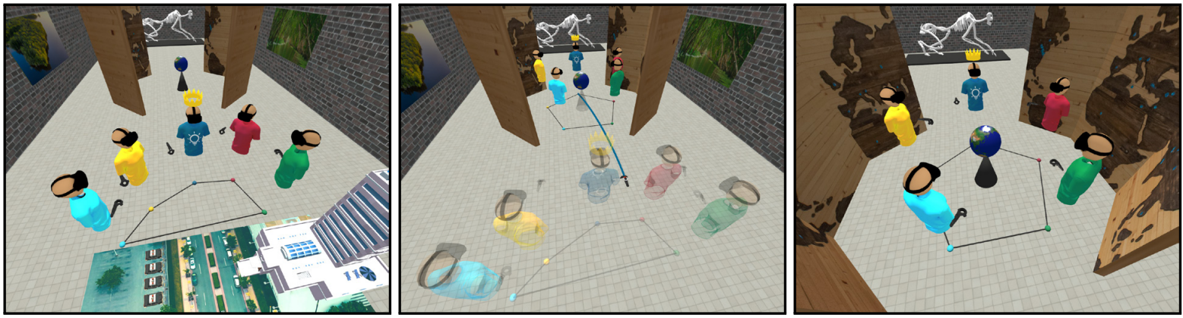
Fig. 1. Left: Five distributed users discuss with each other in a virtual museum. The group’s spatial extent is visualized on the floor by the convex hull of the projected head positions. Center: The guide of the group plans a jump to another exhibit and rearranges the group to a circle formation for improved joint observation. Right: After the jump, the group ends up in the specified formation.

Slide 11
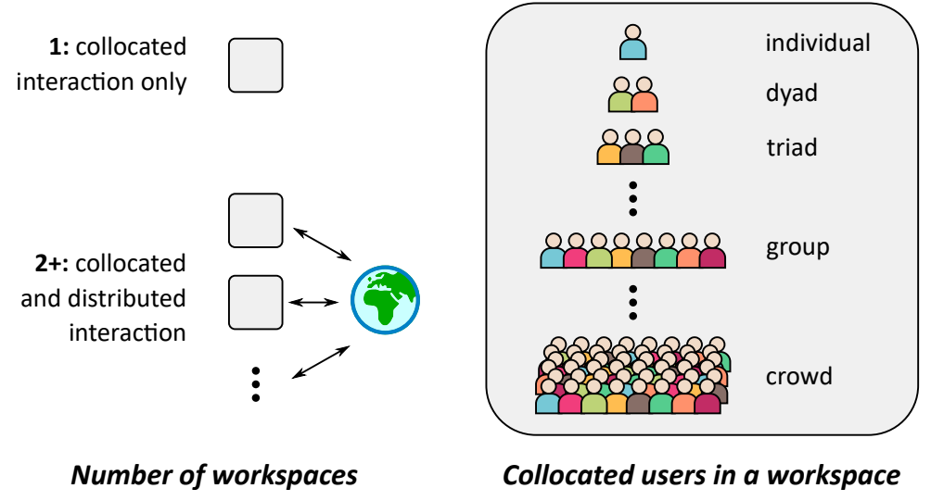
Fig. 2. We classify group interactions in virtual reality by the number of involved distributed workspaces (left) and the number of collocated users within each of these spaces (right). This paper focuses on group navigation techniques for distributed groups with one person per workspace.

Slide 12
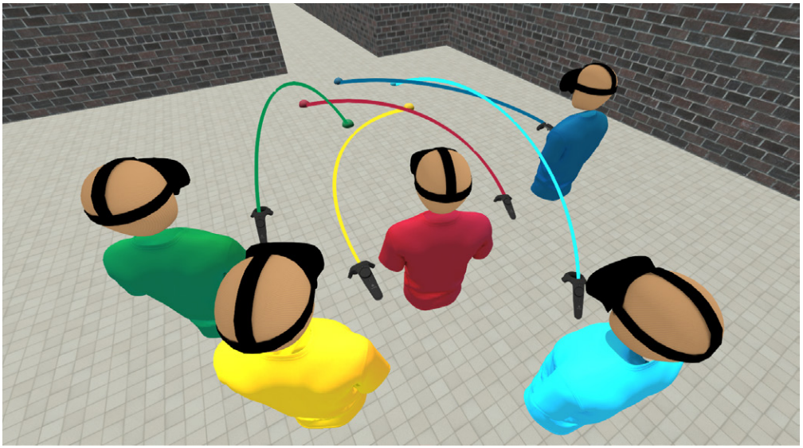
Fig. 3. In prior work for dyads, displaying one target ray per user was deemed helpful and comprehensible for joint navigation [60,61]. However, for larger groups, tracing one target ray per user can be confusing, especially if the formation of the group changes during the jump.

Slide 13
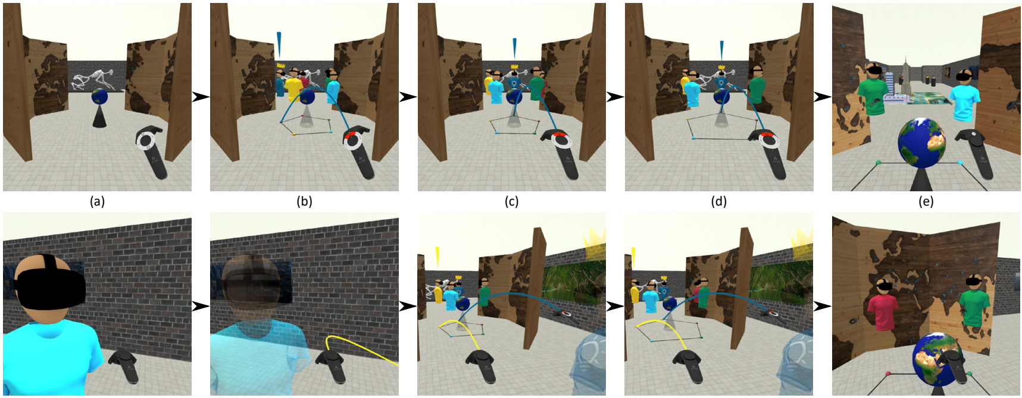
Fig. 4. Interaction sequence for executing the formation-changing jump in Figure 1 from the guide’s (top row) and the yellow attendee’s (bottom row) point of view. (a) The guide opens the radial menu around the controller’s touchpad to select a formation. The attendee may be interacting with another group member and therefore not looking in the same direction as the guide. (b) The guide selects a circle formation by pressing and holding the touchpad button in the respective segment. Preview avatars allow the guide to predict how the group will be arranged after the jump. A secondary target ray only visible to attendees as well as the faded main avatars direct attendees’ focus of attention towards the preview avatars. (c) The roll angle of the guide’s controller allows rotation of the previewed group formation around its centroid. Attendees will always know where they will jump to when tracing their personal target ray. (d) Radial swipes on the touchpad of the guide’s controller specify the spatial extent of the group. (e) When the guide has ensured that everyone is ready and releases the touchpad button, the group will be teleported as indicated by the preview avatars.

Slide 14
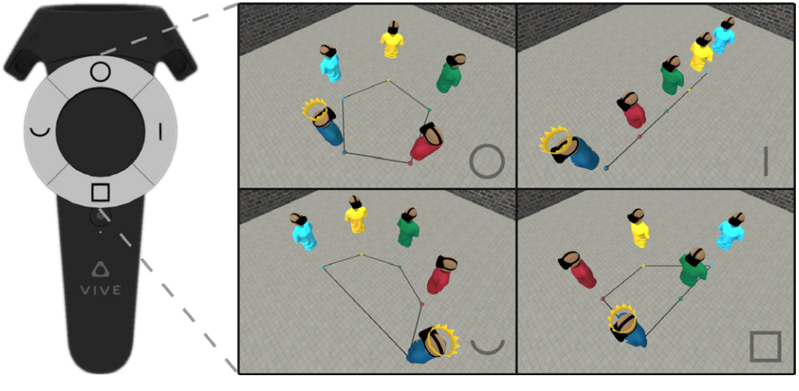
Fig. 5. In our implementation, the guide can choose between four predefined group formations to initiate target specification for a formationchanging jump: circle, queue, horseshoe, and grid.

Slide 15
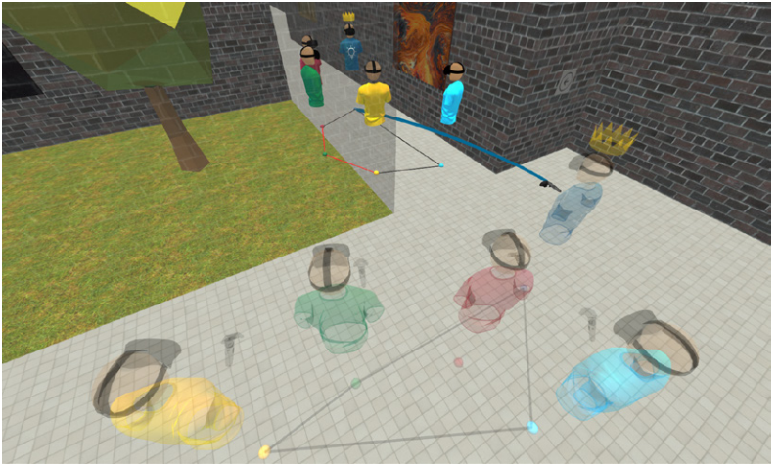
Fig. 6. If the preview avatars are occluded for participants, we suggest fading the corresponding scene geometries. If the previewed convex hull intersects with obstacles, the respective edges are colored in red.

Slide 16
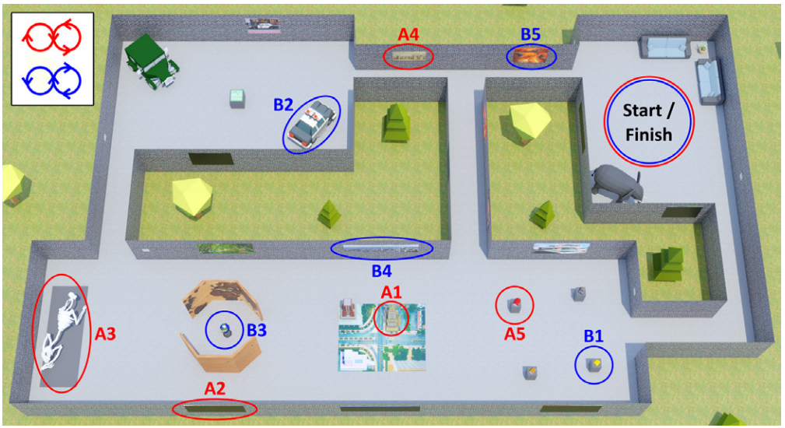
Fig. 7. Top view of the museum in our initial usability study. The guided tours to be conducted by participant A and B, respectively, both started in the welcome lounge (top right), followed a figure-eight pattern through the rooms, and covered five exhibits to be presented to the group.

Slide 17
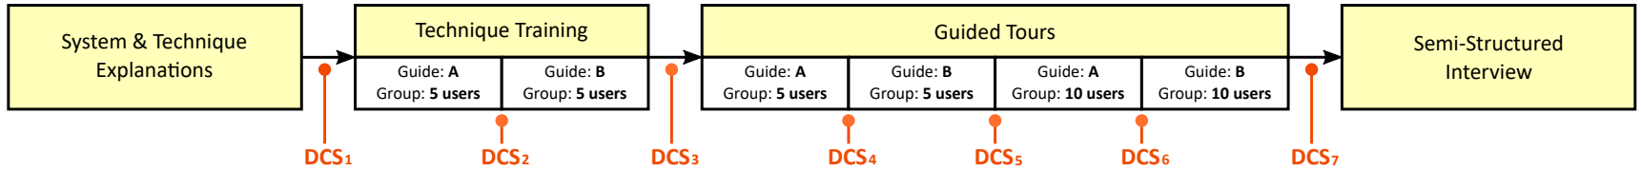
Fig. 8. Procedure diagram of our initial usability study (introduction and conclusion omitted for simplicity). After the initial technique explanations by the experimenter, Participants A and B took turns in training and performing guided tours for the rest of the group. At various points across the study, we asked participants for their current discomfort score (DCS) to be able to intervene if necessary.

Slide 18
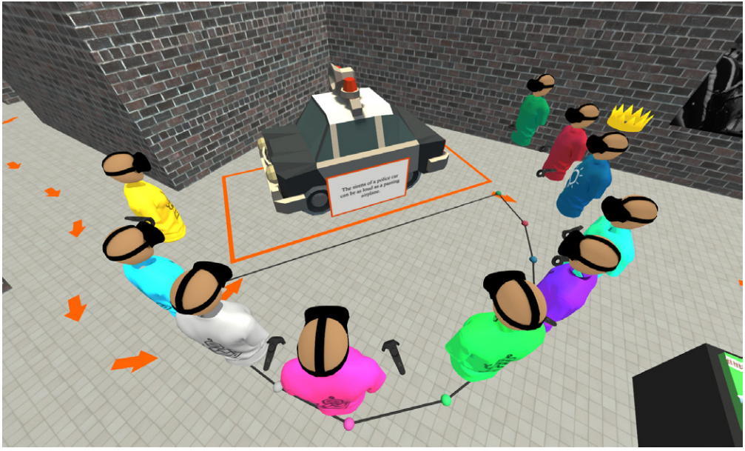
Fig. 9. A guide, two real attendees, and seven simulated attendees observe a virtual car as part of a guided tour in the 10-user condition of our usability study. The orange arrows, highlights, and additional information panels were visible to the guide but not the attendees to simulate the common asymmetric knowledge distribution in guided tours.

Slide 19
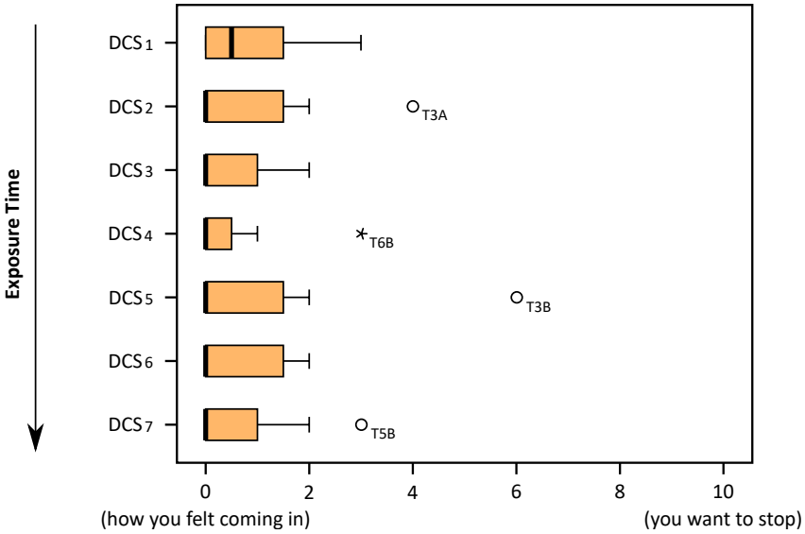
Fig. 10. Boxplots showing the distribution of discomfort scores (DCS) at the measurement points illustrated in Figure 8. N = 12 per boxplot. Circles and asterisks denote outliers and extreme values based on Tukey’s fences with k = 1.5 for outliers and k = 3.0 for extreme values [57].

Slide 20
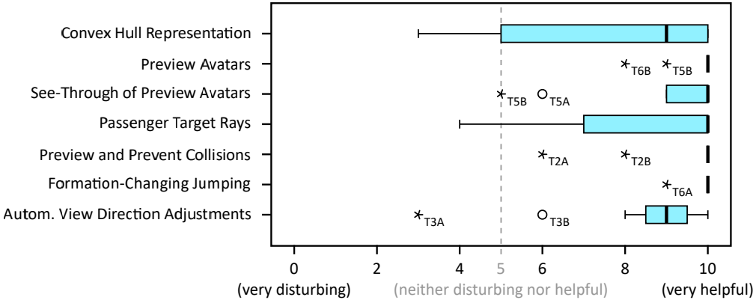
Fig. 11. Boxplots showing the distribution of responses to our concluding feature scoring questionnaire, where each feature was rated on a scale from 0 (very disturbing) to 10 (very helpful). N = 12 per boxplot. Circles and asterisks denote outliers and extreme values based on Tukey’s fences with k = 1.5 for outliers and k = 3.0 for extreme values [57].

Slide 21
結論與未來展望

Slide 22
結論與未來展望
群體導航技術透過減少輸入冗余和協調導航協定，有效促進集體旅行。確定了三個關鍵要求：理解性、避障和視角最佳化，並使用跳躍作為核心隱喻開發了相應技術，我們的研究主要設計適用於小型群體（5-10使用者）的有效群體導航。

Slide 23
結論與未來展望
未來研究可以探索替代的旅行隱喻，如轉向或飛行。此外，應進一步發展以應對較大群體，例如學校班級。雖然本文重點放在分散的個體上，未來的工作應考慮將同地區和分散的使用者組合起來，尋找在群體導航中解決空間轉換的方案。

Slide 24
結論與未來展望
總結而言，初階階段的群體導航研究具有廣泛的潛力。群體導航對於社交虛擬環境至關重要；我們計劃將研究成果整合到商業平台中。這一步旨在激發對於在多用戶虛擬現實中進行高效群體導航的討論，並鼓勵探索實現理解性、避障和視角最佳化的替代方法。

Slide 25
Thank you for your attention!

